Slide 1
INSURANCE COST MACHINE LEARNING
GROUP 5

Slide 2
AGENDA
PROJECT OVERVIEW
TOPIC BACKGROUND
DATA SOURCE & PACKAGES
DATA EXPLORATION
TABLEAU
JUPYTER NOTEBOOK
DATA MODELING
LINEAR REGRESSION
RANDOM FOREST
NEURAL NETWORK
MODEL FINDINGS
LINEAR REGRESSION
RANDOM FOREST
NEURAL NETWORK
CONCLUSION

Slide 3




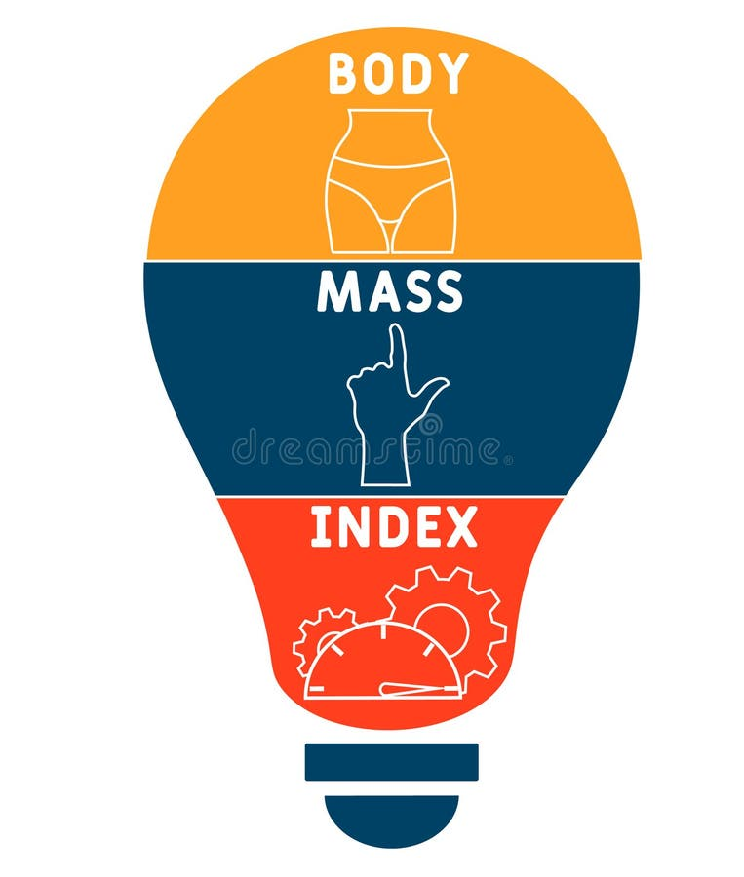
PROJECT OVERVIEW & TOPIC BACKGROUND

Slide 4
DATA SOURCE & PACKAGE INSTALL
Kaggle
Packages:
Spark packages
Pandas
OS library
Matplotlib
Numpy
Scikit Learn
Tensorflow
Keras

Slide 5
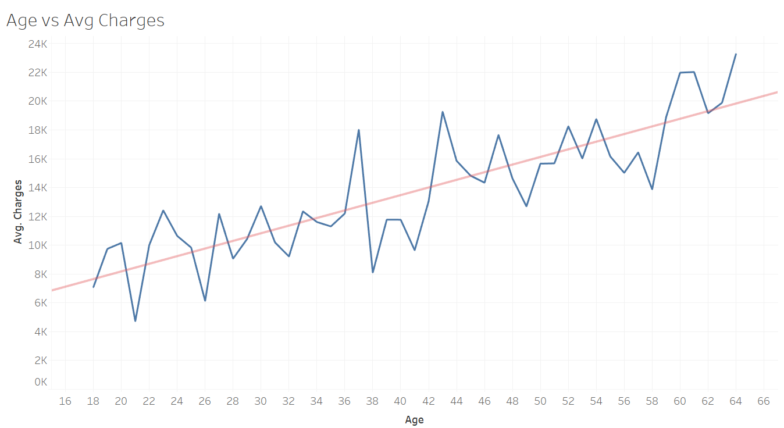
DATA EXPLORATION - TABLEAU
Insurance costs increase with age

Slide 6
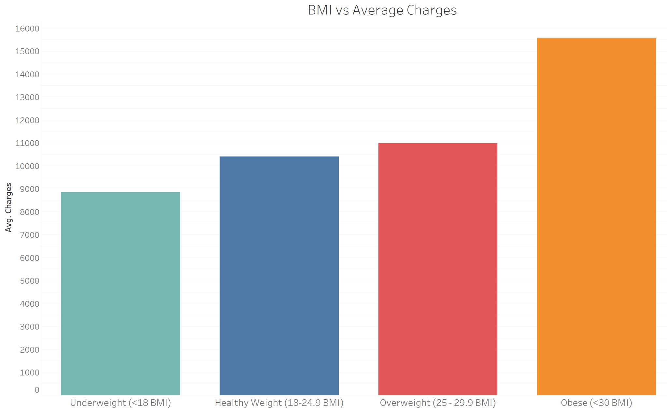
DATA EXPLORATION - TABLEAU
The greater the weight, the higher the associated insurance charges.

Slide 7
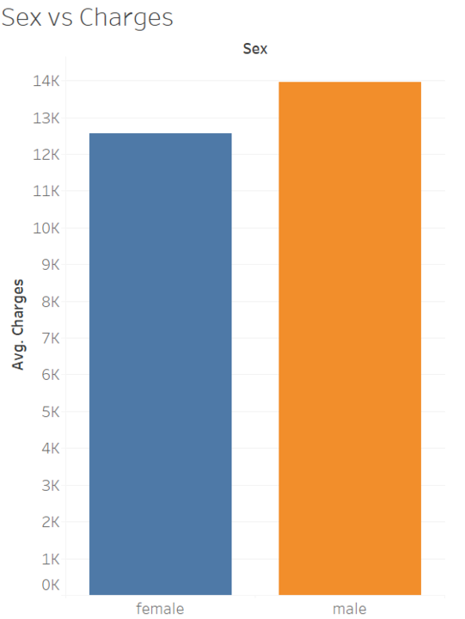
DATA EXPLORATION - TABLEAU
The insurance charges for males are higher than those for females.

Slide 8
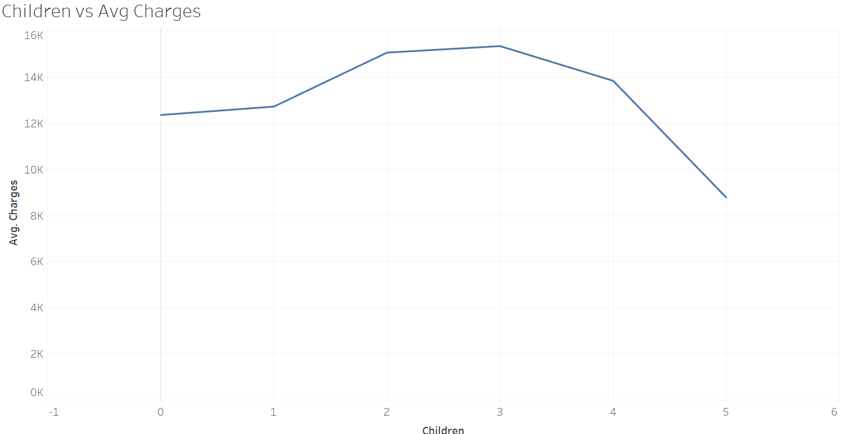
DATA EXPLORATION - TABLEAU
People with three children face the highest insurance charges.

Slide 9
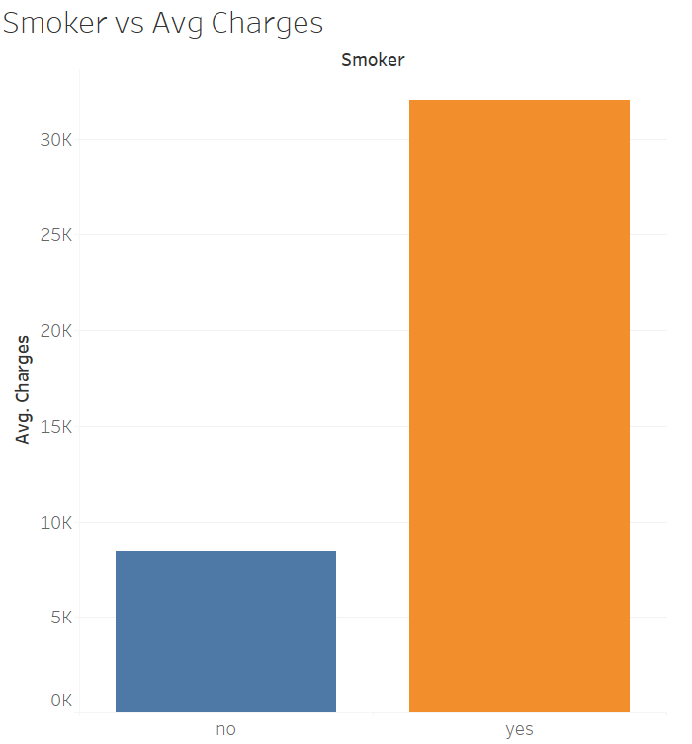
DATA EXPLORATION - TABLEAU
Smokers incur higher insurance costs.

Slide 10
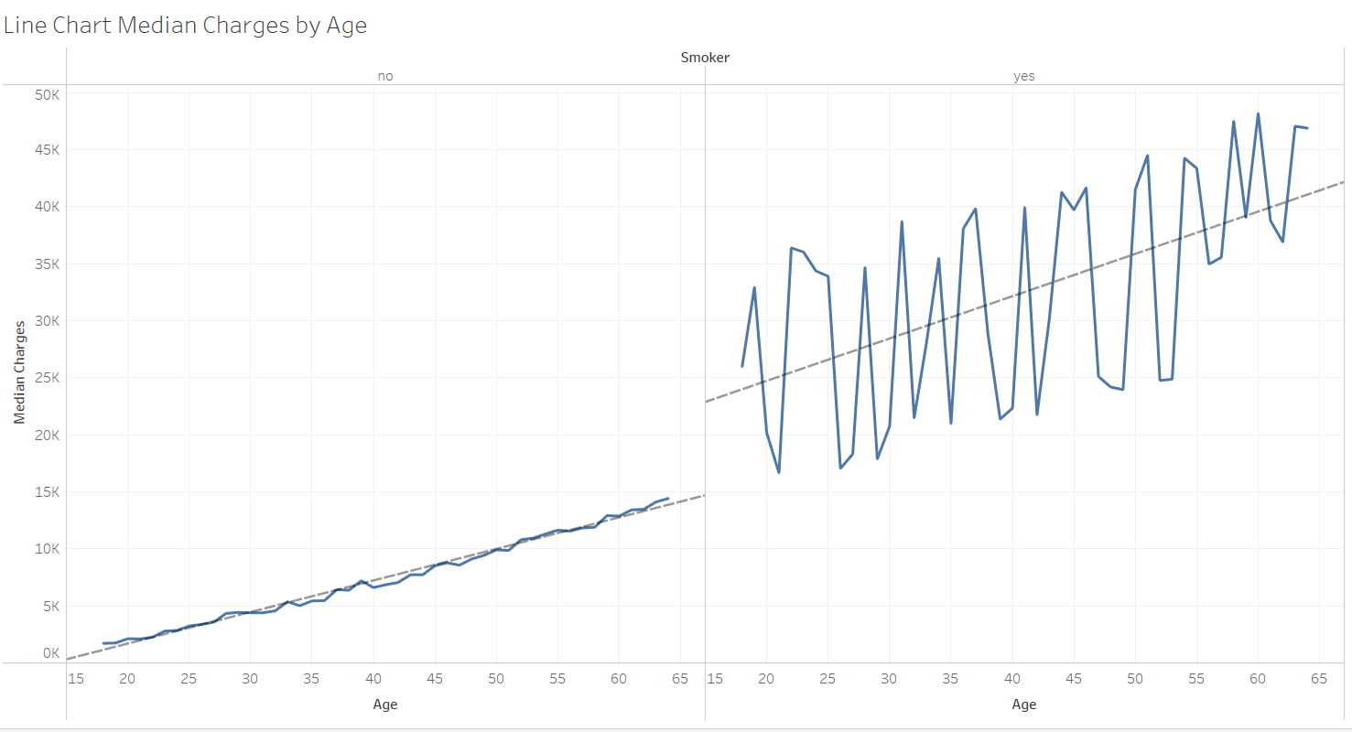
DATA EXPLORATION - TABLEAU
Being both older and a smoker will result in significant insurance on average.

Slide 11
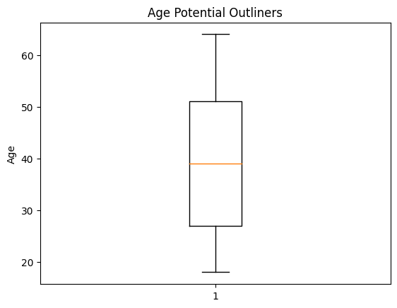
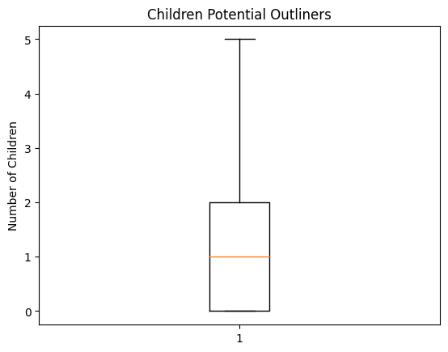
DATA EXPLORATION - ETL in Jupyter Notebook
No Outliner Found for Age and Children Variables

Slide 12
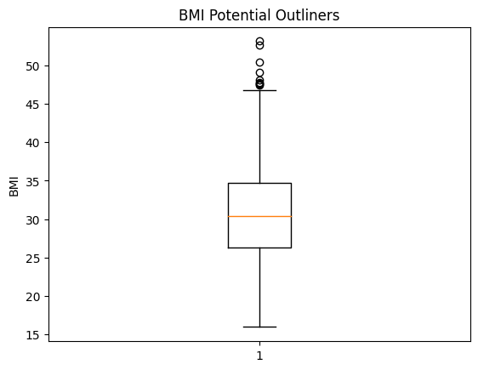
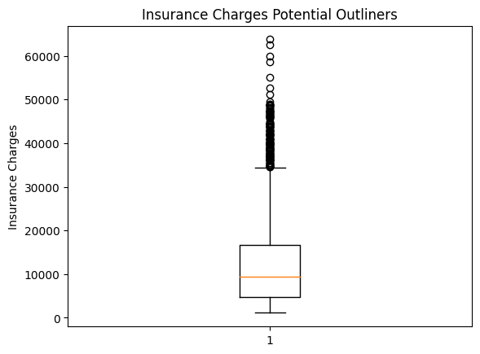
DATA EXPLORATION - ETL in Jupyter Notebook
The boxplot for BMI and insurance charges reveals potential outliers in these variables.

Slide 13
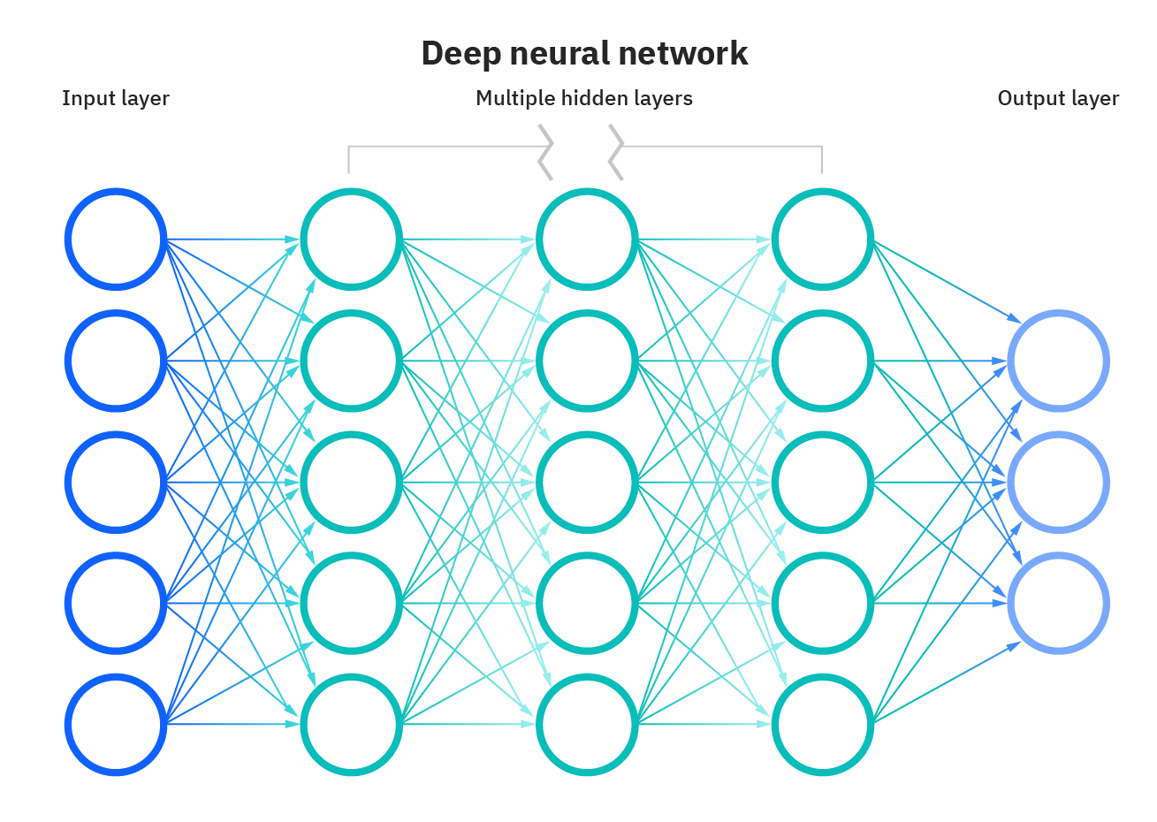
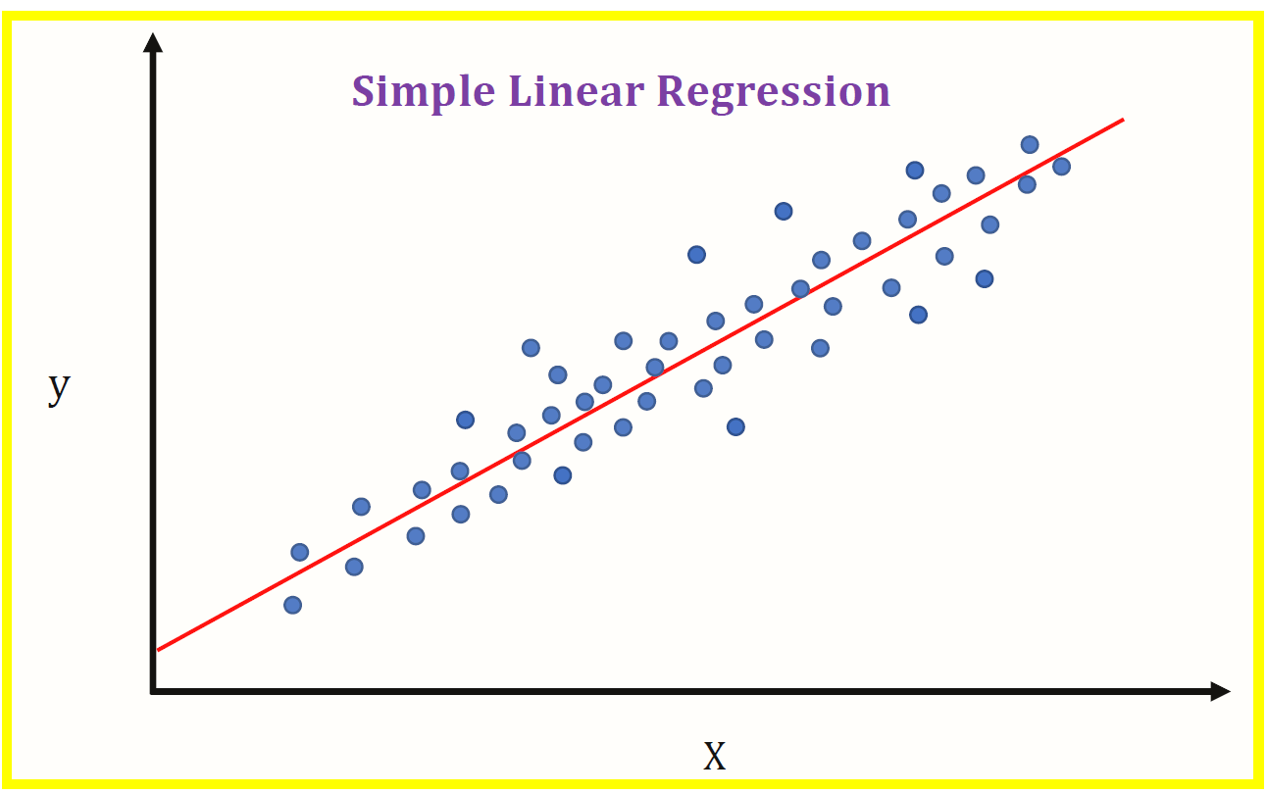
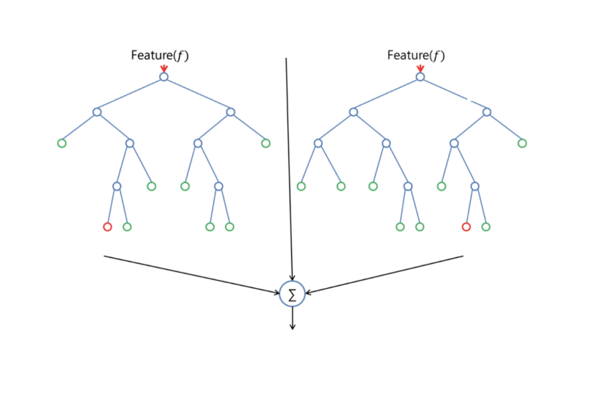
DATA MODELING & FINDINGS - OVERVIEW
Neural Network
Linear Regression
Random Forest

Slide 14
DATA MODELING & FINDINGS - LINEAR REGRESSION
Model Benefits
Analysis
Findings
Simplicity
Easy implementation
Interpretable
Used Tableau to perform exploratory analysis
Evaluated two models
All the independent variables in the dataset
Removed not statistically significant variables (sex, number of children & region)
Model 1:
The r2 score is : 0.734
The mean squared error : 35791108.9
The root mean squared: 5982.6
Model 2:
The r2 score is : 0.727
The mean squared error : 36733495.7
The root mean squared: 6060.8

Slide 15
DATA MODELING & FINDINGS - RANDOM FOREST
Model Benefits
Analysis
Findings
Handles the complexity of the data well
Is less affected by outliers in the data
Create original model
Model 1:
The r-squared value: 0.82
The mean squared error: 23770253.02
The root mean squared error: 4875.47

Slide 16
DATA MODELING & FINDINGS - NEURAL NETWORK
Model Benefits
Analysis
Findings
Model 1:
The r-squared score: -1.3
Loss: 11.63
Model 2:
The r-squared score: -1.4
Loss: 83.22
Model 3:
The r-squared score: 0.63
Loss: 0.14
Model 4:
The r-squared score: 0.65
Loss: 0.14
More options to modify to achieve higher accuracy
Can learn complex relationships between input and output
Create original model
Add additional layers
Change activation function to linear
Add 100 epochs to each iteration

Slide 17
CONCLUSION
R-Square of 0.82
Explain 82% of the variation of the insurance charge using Age, Numbers of Children, Smoking Habit, BMI Measures, and Regions
Smoking habit has the most significant impact on the insurance rate, following by BMI measure and age.
Notes:
Mathew

Slide 18
Next Steps
What we can do to improve our models
Bigger dataset
Insurance Plan categories information
Medical spend

Slide 19

Thank you!
Thanks Hunter, Sam and Randy for your help!

Slide 20
REFERENCE
https://www.healthcare.gov/how-plans-set-your-premiums/
https://www.healthaffairs.org/doi/10.1377/hlthaff.2023.00996
https://medium.com/luca-chuangs-bapm-notes/build-a-neural-network-in-python-regression-a80a906f634c
https://thecleverprogrammer.com/2021/10/26/health-insurance-premium-prediction-with-machine-learning/

